Slide 1


Slide 2


Design and Implementation of a Mini Relational Database Engine
2nd Year Project Progress
Submitted by
ROLL | NAME
2401730183 | Chirag Sharma
2401730170 | Vikram
2401730213 | Saurav Kumar
2401730196 | Ansh Jangid
2401730076 | Utkarsh
Faculty Mentor: Mr. Vishwanil Suman
Notes:
New Courses replaced with New Programmes

Slide 3

Project Overview
The Mini Database Management System (Mini DBMS) is a lightweight database system developed to perform basic database operations such as storing, retrieving, and managing data.
This project demonstrates the working principles of a DBMS including:
Query processing
Data storage
Data retrieval
Table management
The system uses a Java-based backend engine to process SQL-like queries and a web-based frontend to interact with the user.
Notes:
New Courses replaced with New Programmes

Slide 4
Specific Objectives
To design a simplified database management system.
To implement basic SQL operations such as SELECT, INSERT, and DELETE.
To develop a query parser that understands user commands.
To store and manage data using CSV files as tables.
To create a user-friendly frontend interface for interacting with the database.
Notes:
New Courses replaced with New Programmes

Slide 5
Key Features
Simple SQL Query Execution
Create and manage multiple tables
Insert, delete and retrieve data
Java-based backend engine
Frontend interface using HTML, CSS, and JavaScript
Data stored in CSV format
Lightweight and easy to run
Notes:
New Courses replaced with New Programmes

Slide 6
Progress Summary
The following progress has been completed so far:
Designed the overall system architecture
Developed the backend DBMS engine in Java
Implemented query parser
Implemented data storage using CSV files
Created frontend interface
Connected frontend with backend server
Notes:
New Courses replaced with New Programmes

Slide 7
Detailed Progress – Development Phase
During the development phase:
Designed backend classes such as
SQLParser
QueryExecutor
StorageManager
Implemented data storage system.
Created tables using CSV files.
Developed frontend interface using:
HTML
CSS
JavaScript
Integrated frontend and backend communication.
Notes:
New Courses replaced with New Programmes

Slide 8
Methodology
The project follows the following methodology:
Requirement Analysis Understanding the functionalities required in a DBMS.
System Design Designing architecture including frontend and backend modules.
Implementation Coding the database engine and user interface.
Testing Running queries and verifying outputs.
Deployment Running the system locally for user interaction.
Notes:
New Courses replaced with New Programmes

Slide 9
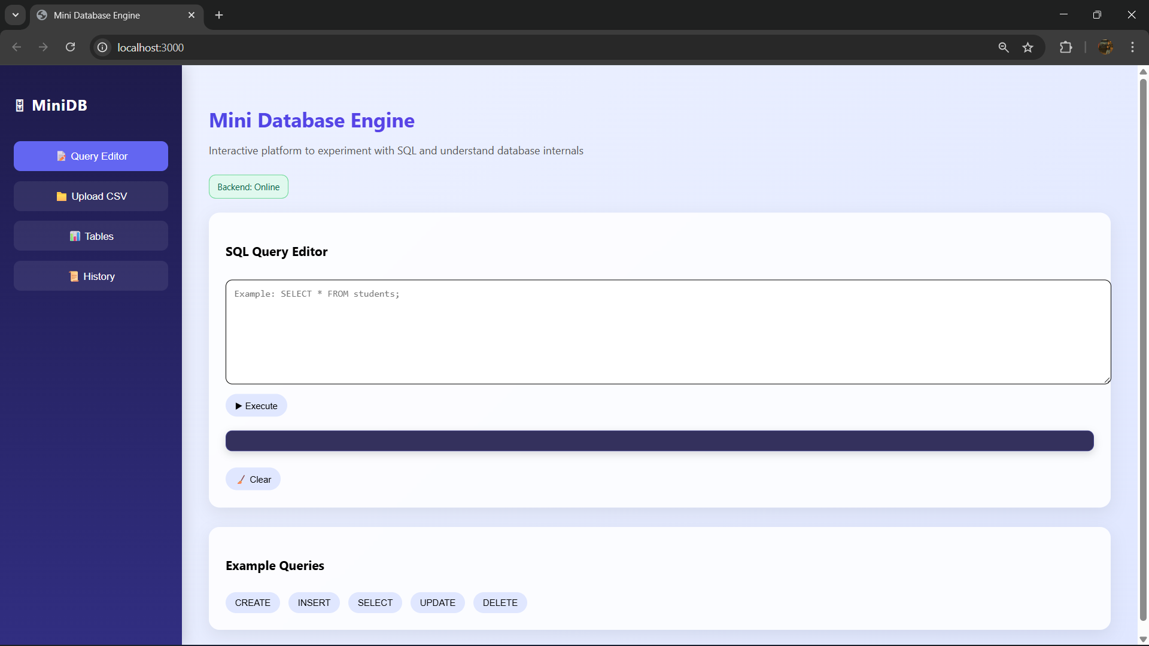
Prototype
Notes:
New Courses replaced with New Programmes

Slide 10
Project Timeline
Phase | Work
Week 1 | Project planning
Week 2 | Frontend development
Week 3 | Backend DBMS development
Week 4 | Query parser implementation
Week 5 | Integration and testing
Notes:
New Courses replaced with New Programmes

Slide 11
Next Steps and Goals
Future improvements for the project include:
Adding more SQL operations
Adding authentication system
Improving the UI design
Supporting larger datasets
Adding Chatbot
Notes:
New Courses replaced with New Programmes

Slide 12
Data & Resources
Resources used in the project:
Programming Languages:
Java
HTML
CSS
JavaScript
Tools Used:
VS Code
GitHub
Local server
Notes:
New Courses replaced with New Programmes

Slide 13
Project Usecases & Scope
Usecases:
Learning basic DBMS concepts
Understanding query processing
Educational purposes
Small-scale data management
Scope:
Can be expanded to support advanced SQL queries
Can be converted into a full database engine
Notes:
New Courses replaced with New Programmes

Slide 14
Expected Results & Impact
Expected outcomes:
Working Mini DBMS system
Ability to perform basic database operations
Better understanding of database architecture
Impact:
Helps students understand how DBMS works internally
Demonstrates practical implementation of database concepts
Notes:
New Courses replaced with New Programmes

Slide 15
THANK YOU

